Slide 1

MODELING UDE & H∞ CONTROLLER FOR MAGLEV APPLICATION
ECE533
ROBUST CONTROL
GUIDED BY: Dr. QING-CHANG ZHONG
PRESENTED BY: Er. ANIRUDHA BEHERA
MS IN ELECTRICAL ENGINEERING
ID:A20503687

Slide 2
INTRODUCTION:
1
Automatic control systems have been widely used in modern industries, and many other fields. So far, we have an enormous spread of control methods, including UDE control, H∞ control, PID control, fuzzy control, adaptive control, sliding-mode cascaded control, multirate control, Quantitative feedback Control, asymptotic control, and active disturbance rejection control, etc. These control methods have their own characteristics and merits while the requirements on the designer's professional ability are also high. Out of all these control schemes we are going to use UDE and H∞ in this project for a Maglev. The reason of using UDE-based control is, able to quickly estimate uncertainties and disturbances and hence is able to provide outstanding robust performance. The UDE control algorithm is based on the assumption that a signal can be approximated and estimated using a filter with the right bandwidth and the reason behind H∞ is, it has advantages over classical control techniques where H∞ techniques are readily applicable to problems involving multivariable system with cross coupling between channels.
Our aim is to develop two control models using algorithm of UDE and H∞ for given maglev concept. We will perform different investigation of both the systems to analyze the stability of the model.

Slide 3
LITERATURE REVIEW
2
Magnetic levitation:
Magnetic levitation (maglev) or magnetic suspension is a method by which an object is suspended with no support other than magnetic fields. Magnetic force is used to counteract the effects of the gravitational force and any other forces.
Challenges in magnetic levitation:
The two primary issues involved in magnetic levitation are lifting forces which provides an upward force sufficient to counteract gravity, and stability which ensure that the system does not spontaneously slide or flip into a configuration where the lift is neutralized.
History of magnetic levitation:
Magnetic levitation were common in ancient and medieval times, and their spread from the Roman world to the Middle East and later to India has been documented by the classical scholar, Albert Dunstan Lowe.
The earliest known source is Pliny the Elder in first century who described architectural plans for an iron statue that was suspended by the lodestone at a temple in Alexandria.
Another example is the suspended monument in the Konark Sun Temple in Eastern India.

Slide 4
Cont.…
3
1839 Earnshaw's theorem showed electrostatic levitation cannot be stable, later theorem was extended to magnetostatic levitation by others scientist.
1933 Super diamagnetism Walther Meissner and Robert Ochsenfeld discovered the Meissner effect).
2005 homopolar electrodynamic bearing.
Applications of magnetic levitation system:
Acoustic levitation Electrodynamic levitation
Aerodynamic levitation Magnetic bearing
Electrostatic levitation StarTram
Optical levitation Maglev transportation
Cyclotrons Micro robotics
Launch loop
Magnetic bearing

Slide 5
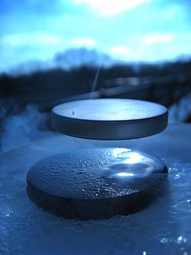
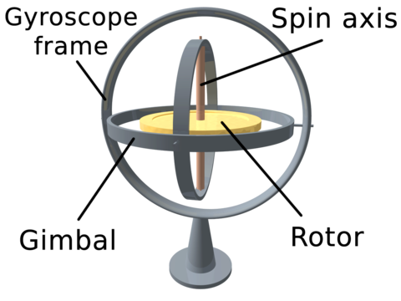
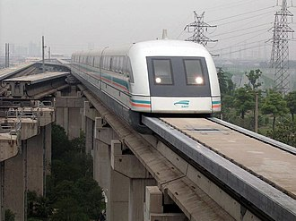
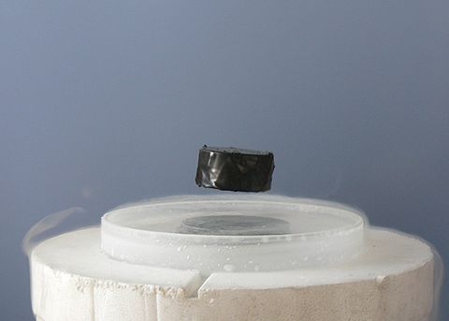
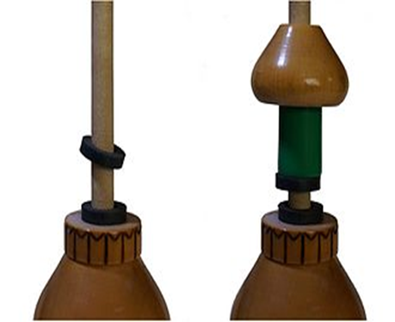
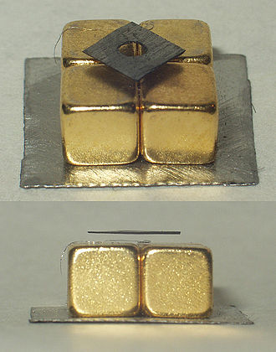


Cont.…
4

Slide 6
PURPOSE
5
The purpose of studying Magnetic Levitator is how magnetic fields are generated and the repulsion force that the system must have in order to avoid the force of gravity that all bodies are affected. This is the starting point to understand how a body could levitate.
Day by day magnetic levitation is becoming a vital part of our mankind. It is widely used in transportation, entertainment, space science, toys and science experiments etc.
So to keep it stable and under control from disturbances and uncertainties we are studying it.
There are several kind of control theories which helps to remove uncertainties from a magnetic levitation system.
Uncertainty and Disturbance Estimator (UDE) Proportional–integral (PI)
H-infinity Proportional Derivative (PD)
Fuzzy-logic Proportional, Integral, Derivative
proportional–integral–derivative (PID)
Here we are designing control system for magnetic levitation using UDE controller and H-infinity controller to compare both result and conclude which one is the better controller in this magnetic levitation context.

Slide 7
STUDY AIM(S)
6
Our Aim of this project is,
Study of open-loop system and closed-loop system for given magnetic levitation system.
Designing UDE controller for given magnetic levitation from given parameters and conditions.
Describing the system with a state-space model.
Formulate a closed-loop H-infinity control system so that the position “q” of the ball can track the position reference “qref”.
Design H-infinity controller for given magnetic levitation from given parameters and conditions.
Comparing both and giving remark.

Slide 8
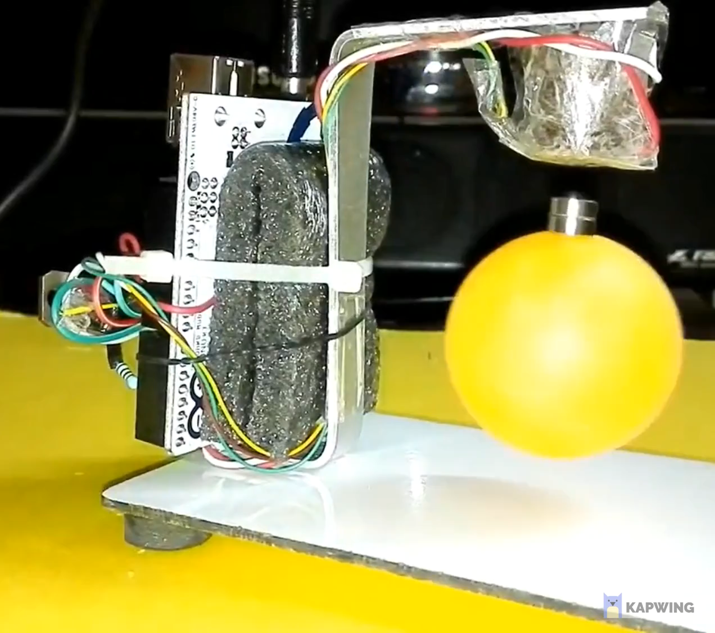
EXAMPLE MODEL
7
CONTROL UNIT/CIRCUIT
ELECTROMAGNET
HALL SENSOR
NEODYMIUM MAGNET
PLASTIC BALL

Slide 9
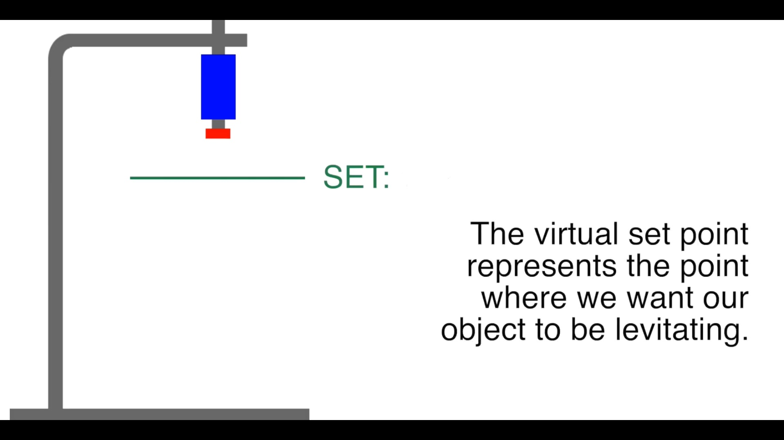
DESIGN STUDY
8
6mm,
4mm,
2mm,

Slide 10
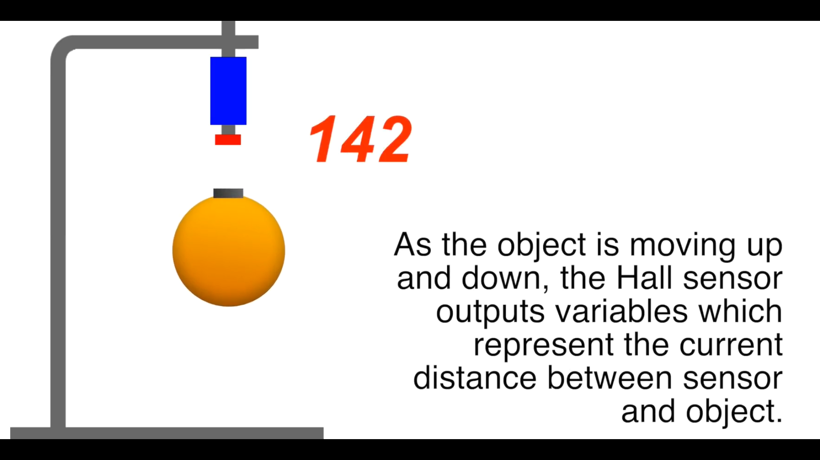
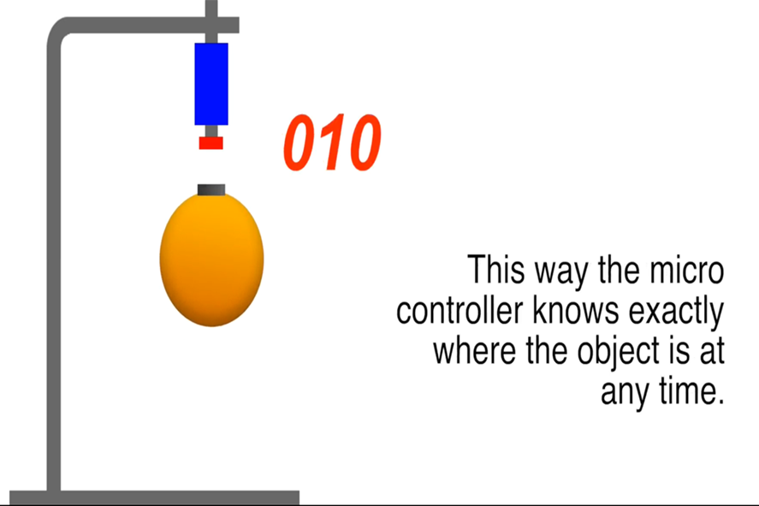

Cont.…
9

Slide 11
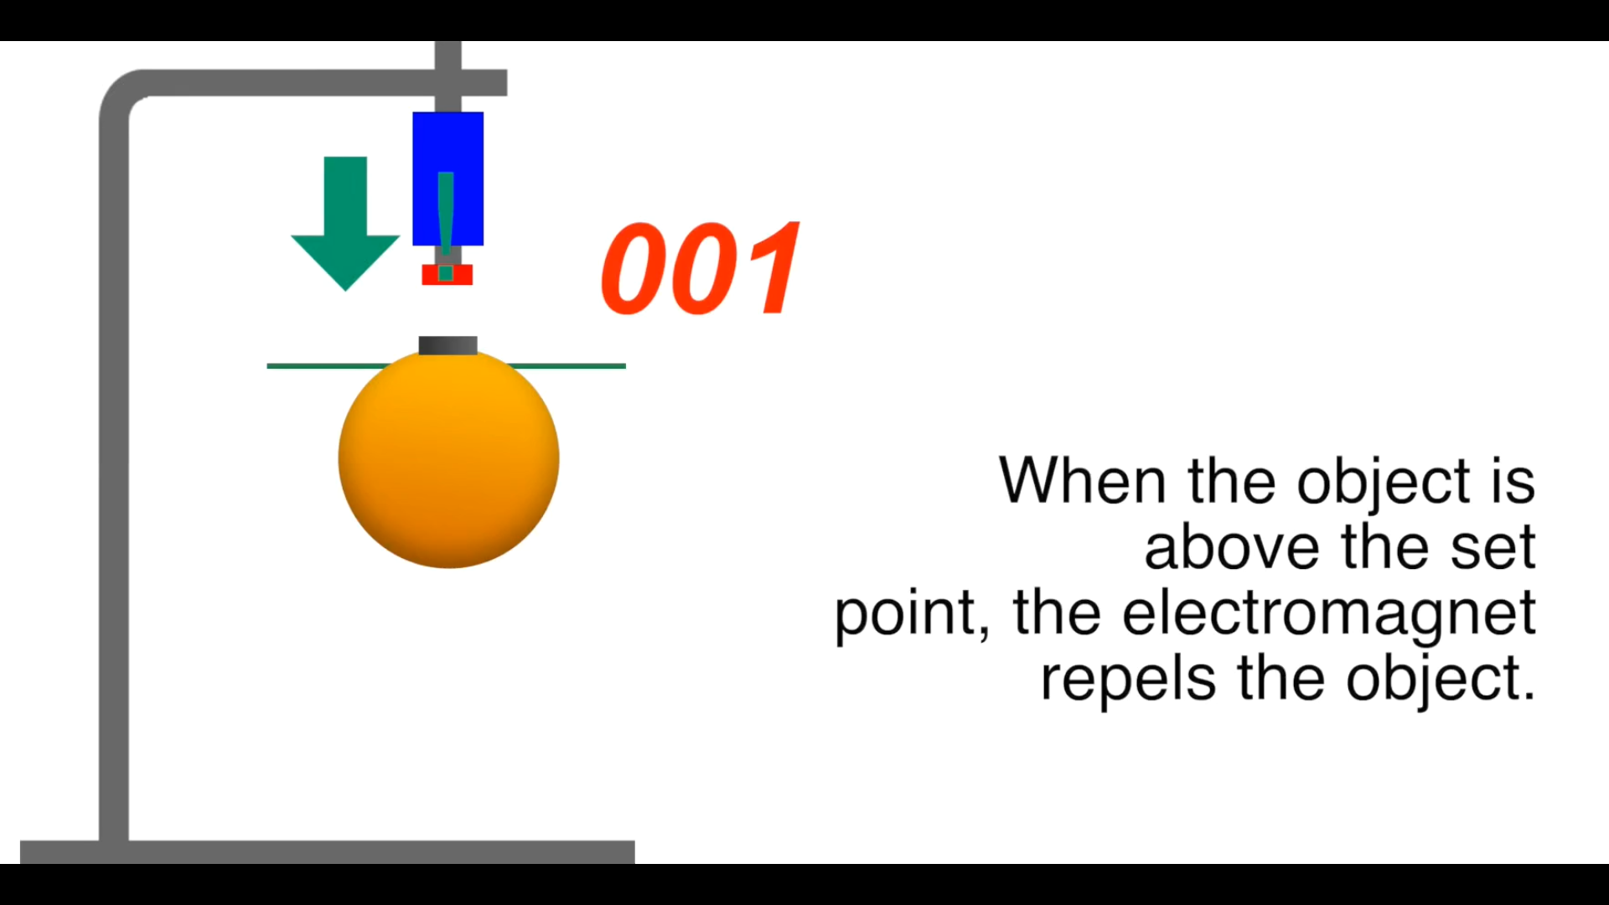
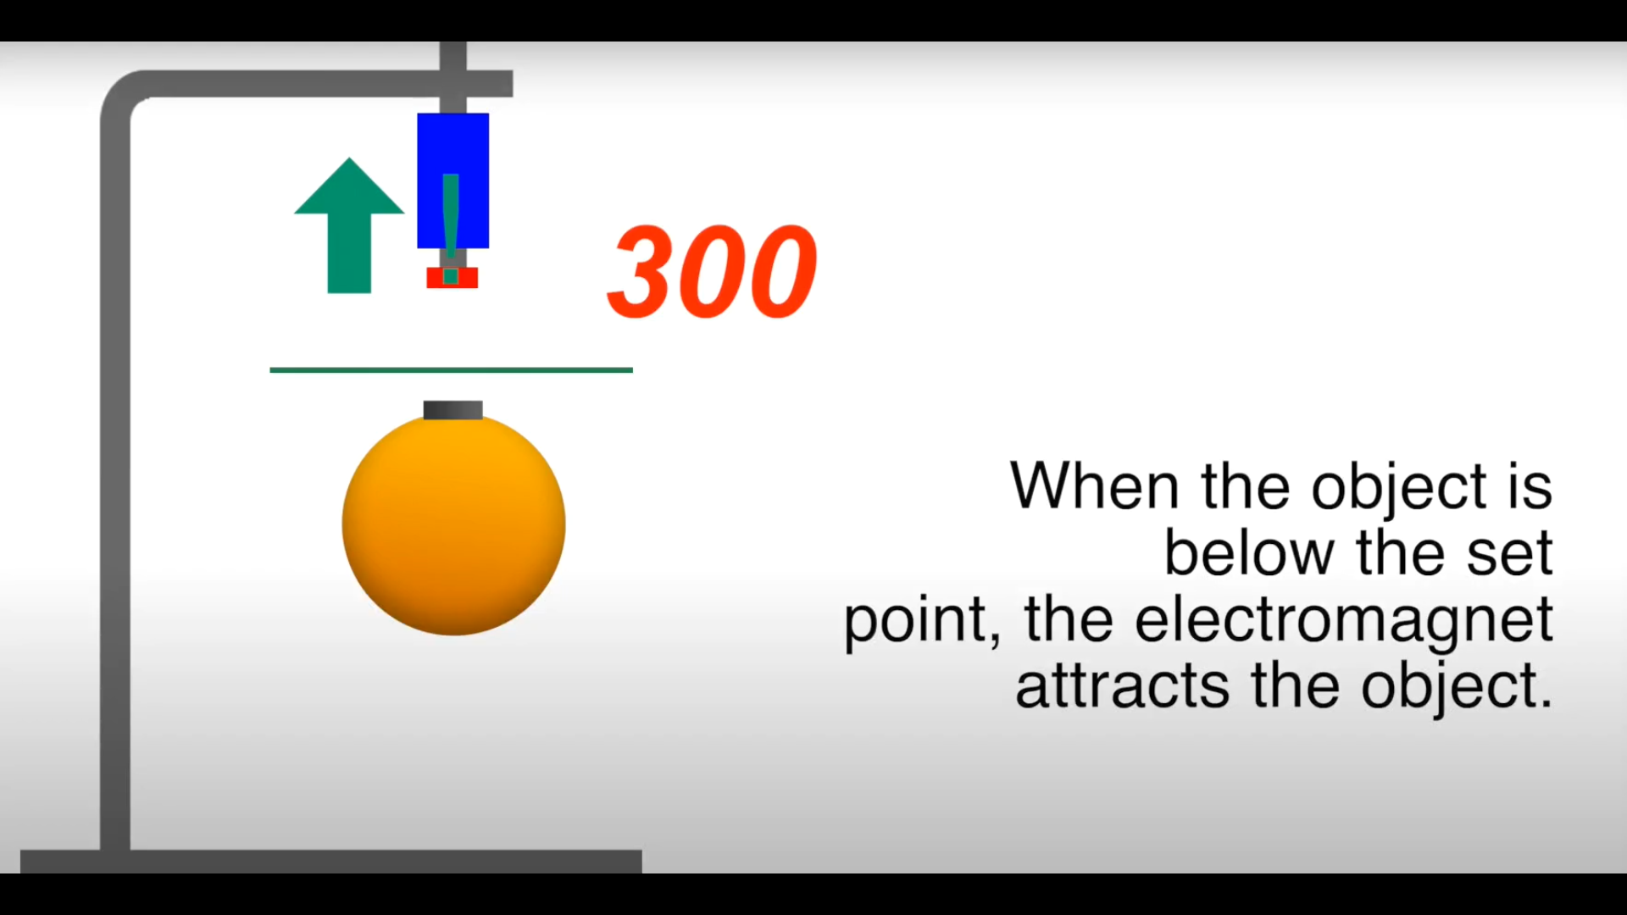
Cont.…
10

Slide 12
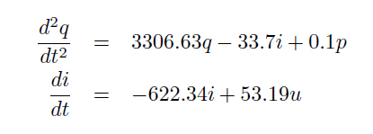
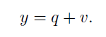
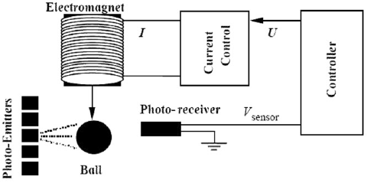
PROJECT WORK
11
GIVEN SYSTEM:
The linearized model of the system is given in the following form,
Where, u = control input
q = position of ball (mm)
q’ = velocity of ball (mm/sec)
p = process disturbances
i = current in winding (Amp)
v = noise

Slide 13
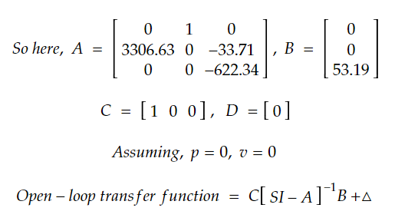
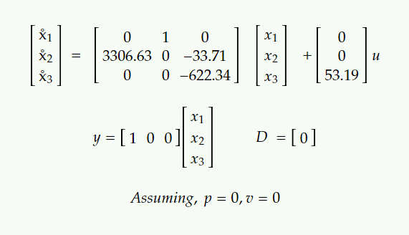
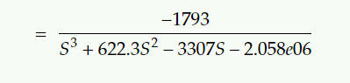
PART:1
12
OPEN-LOOP MAGNETIC LEVITATION SYSTEM:
All practical magnetic levitation systems are inherently open-loop or unstable system, the relay on feedback control or closed-loop control system to produce desired levitation action.
Converting the given data into state space form,
where, x₁ = q, x₂ = q˚, x₃ = i

Slide 14
Cont.…
13
Open-loop block diagram,
Note: It can be seen that the open-loop poles are,
S₁ = 57.503 (RHP)
S₂ = -57.5033
S₃ = -622.3400
Hence, open-loop system is statically unstable.
OPEN-LOOP
TRANSFER FUNCTION
u (Volt)
y (mm)

Slide 15
Cont.…
14
2. CLOSED-LOOP MAGNETIC LEVITATION SYSTEM:
Open-loop transfer function
y
qreff
+
controller
-
y
[Closed-loop block diagram (p=0,v=0)]
Open-loop transfer function
(Plant)
y
qreff
+
Controller (K)
+
-
+
+
+
y
Disturbance (p)
Noise (v)
[Closed-loop block diagram (with p and v )]

Slide 16
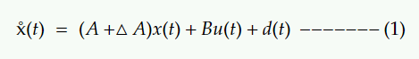
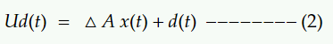
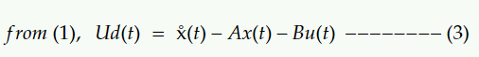
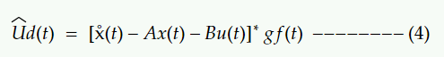
Cont.…
15
DESIGN OF UDE BASED ROBUST CONTROLLER:
Control framework:
consider the uncertain LFT system,
Uncertainty terms are denoted as Ud(t),
Ud(t) is estimated by an UDE law as follows,
Where “ * ” = conventional convolution operator
gf(t)= impulse response of a frequency filter with unity gain & zero phase shift covering the spectrum off Ud.
Control Objective – To design robust control law such that system output could accurately track a reference signal ‘r Є R’ in presence of matched uncertainties(∆ A) and disturbances (p).

Slide 17
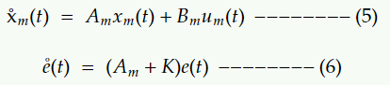
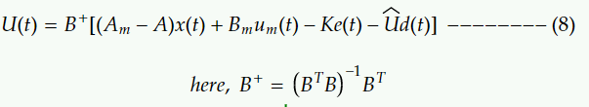
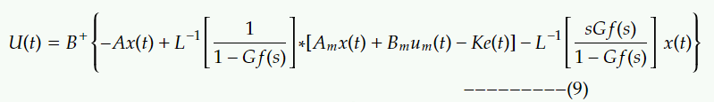
Cont.…
16
For two degree of freedom controller the reference model introduced as,
When ‘K ∈ R\power{n*n}’ is feedback gain such that e(t) reduces exponentially.
Putting (1) & (5) into (6),
Putting (4) into (7),

Slide 18
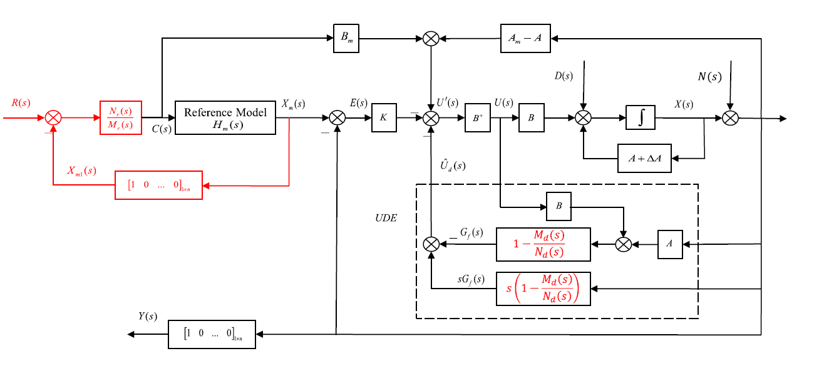
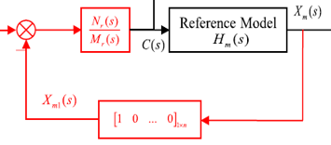
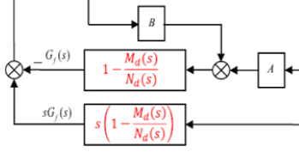
Cont.…
17
UDE Block Diagram:

Slide 19
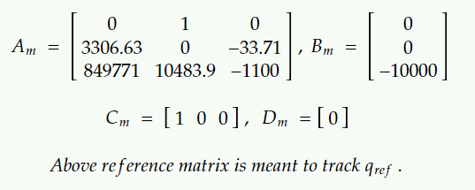
Cont.…
18
The model matrix for controller:
3. According to conditions we have six cases for Q.3:
i.e. qreff = 2mm, 4mm, 6mm
Then, qreff = 2mm, 4mm, 6mm
Note: ∆ A= 0, for these cases.
P=0, v=0
P=50 at t=2s & v=0.1 at t=4s

Slide 20
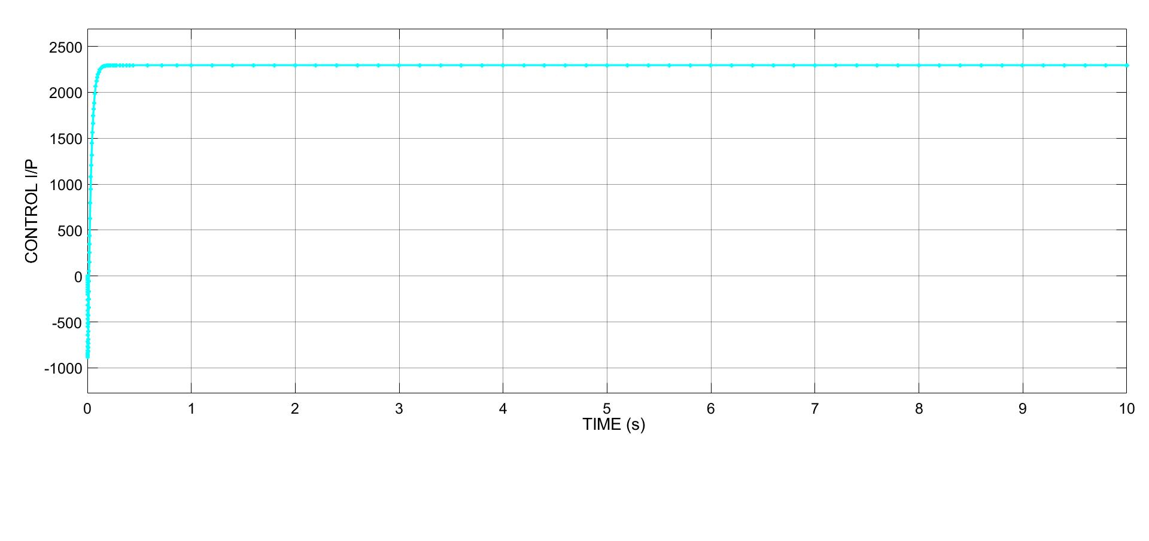
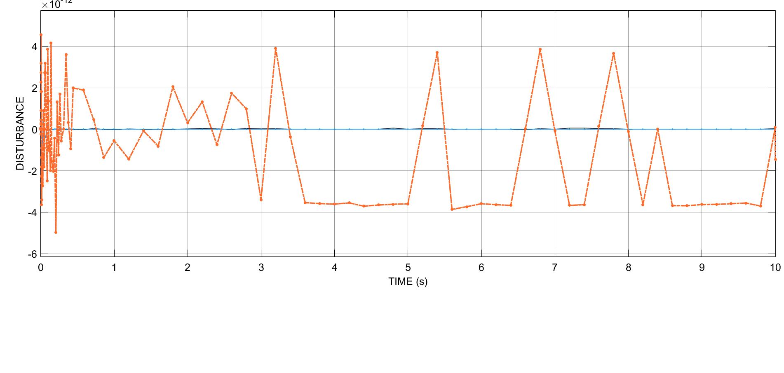
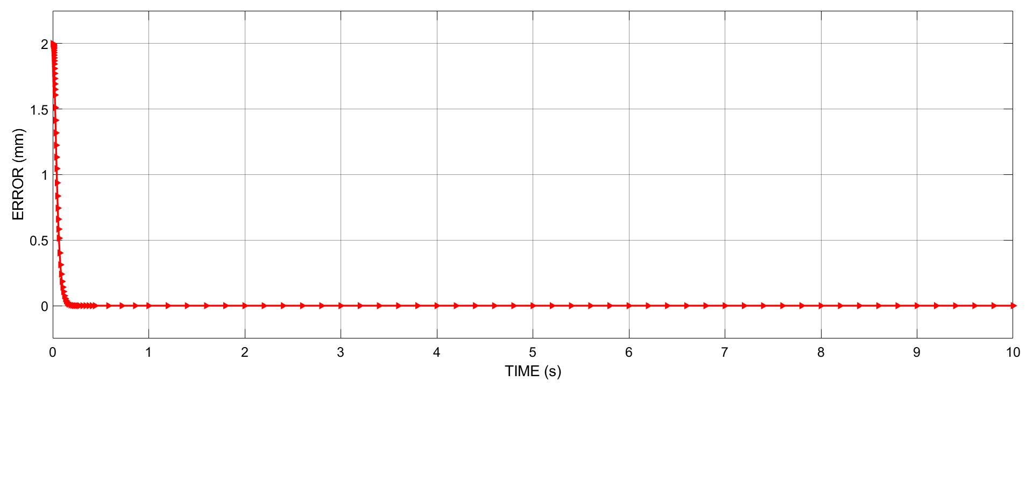
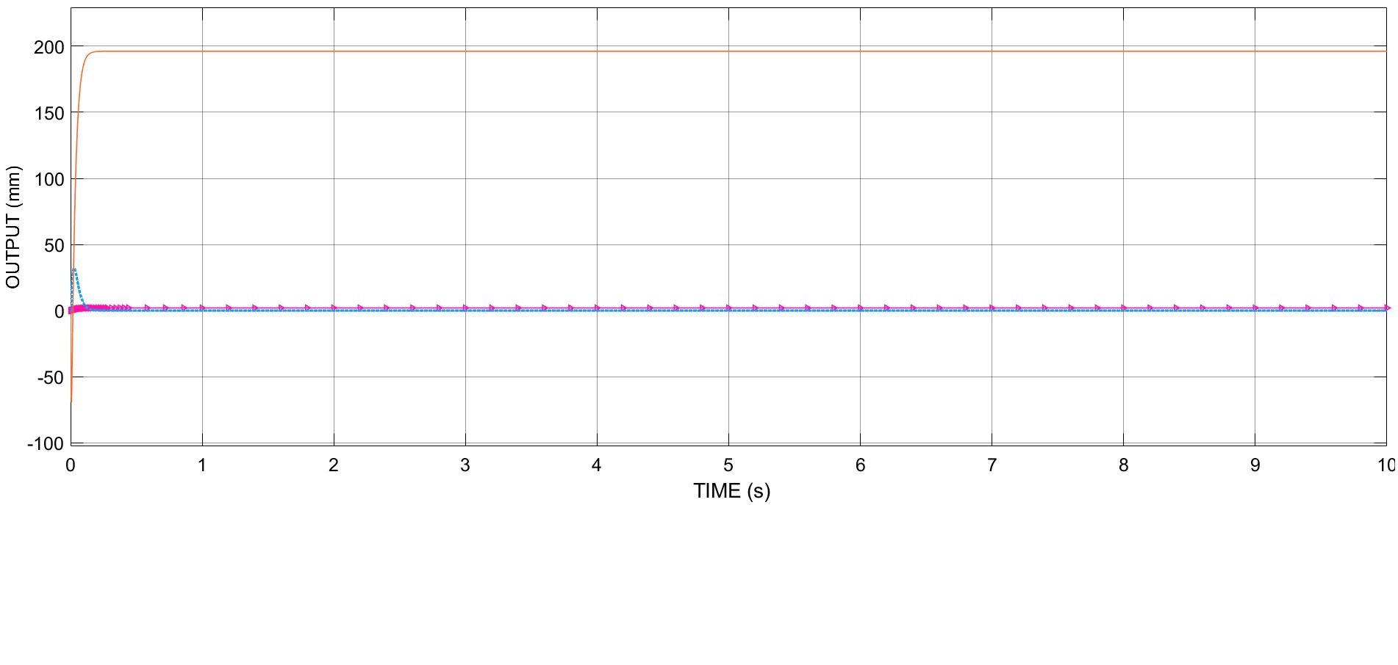
RESULT(S)
19
Case:1-qreff=2mm, p=0, v=0

Slide 21
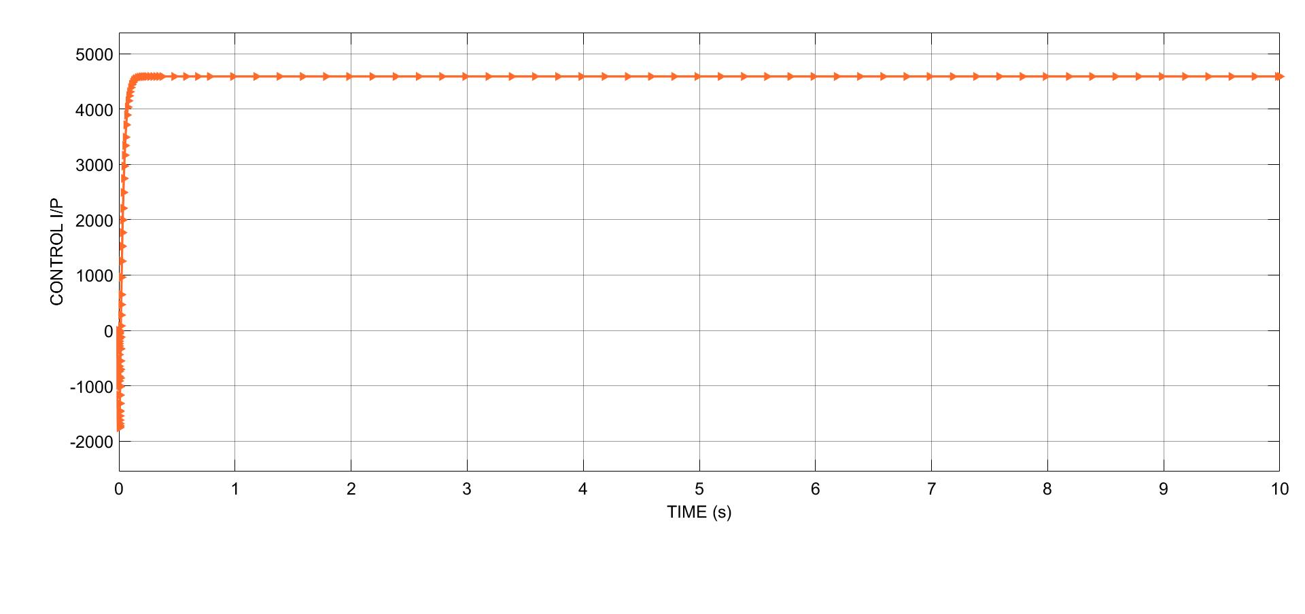
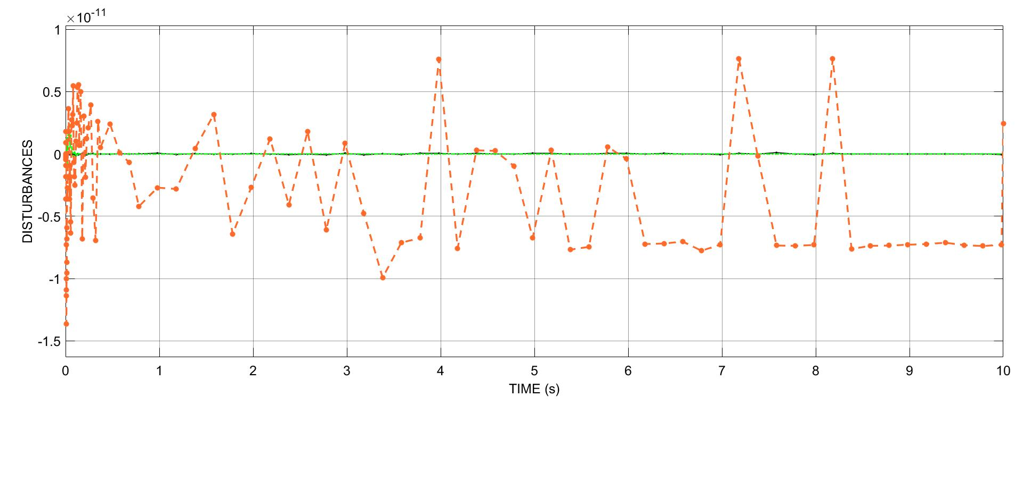
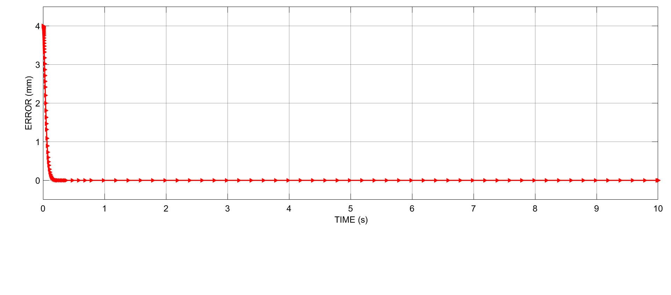
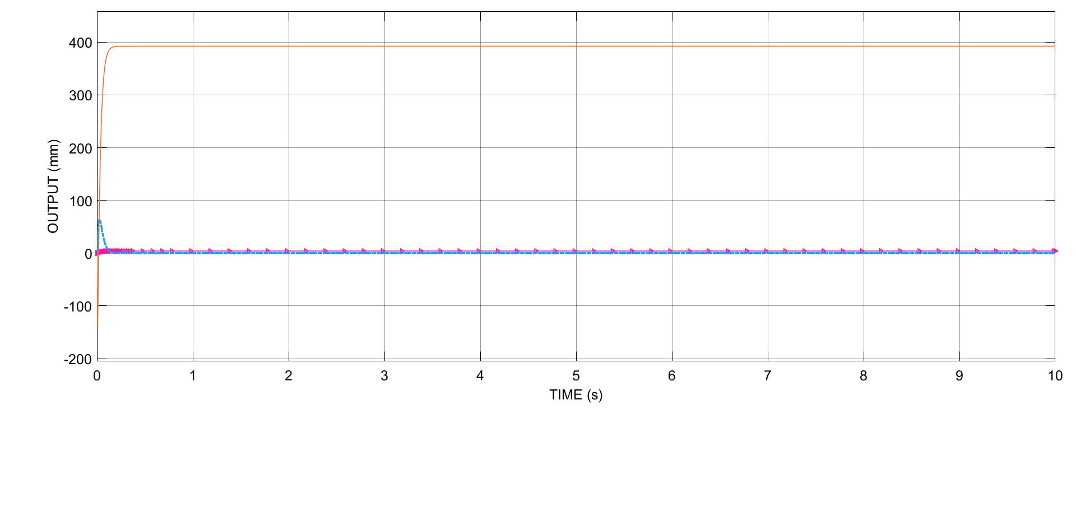
Cont.…
Case:2-qreff=4mm, p=0, v=0

Slide 22
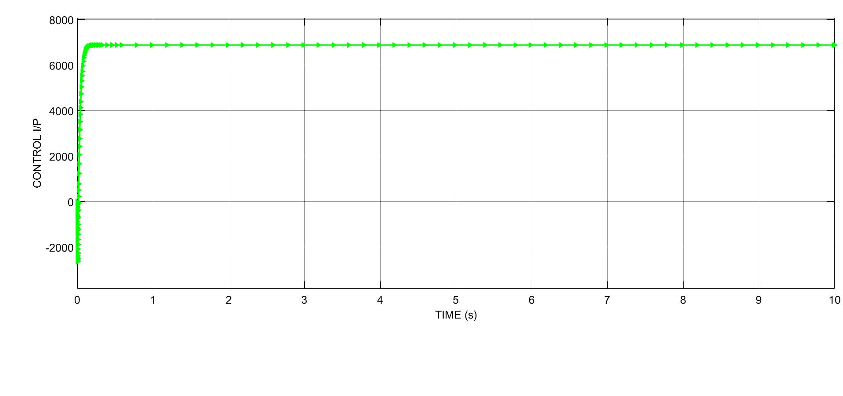
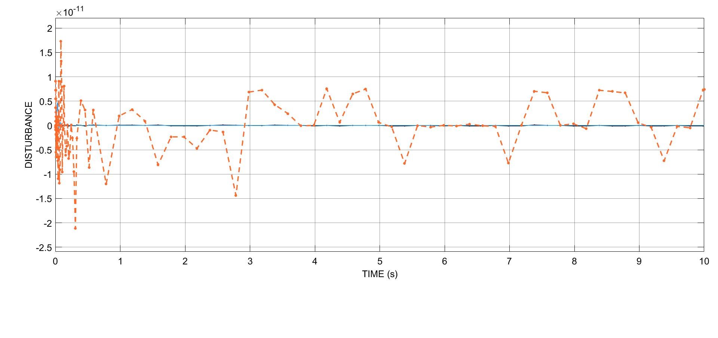
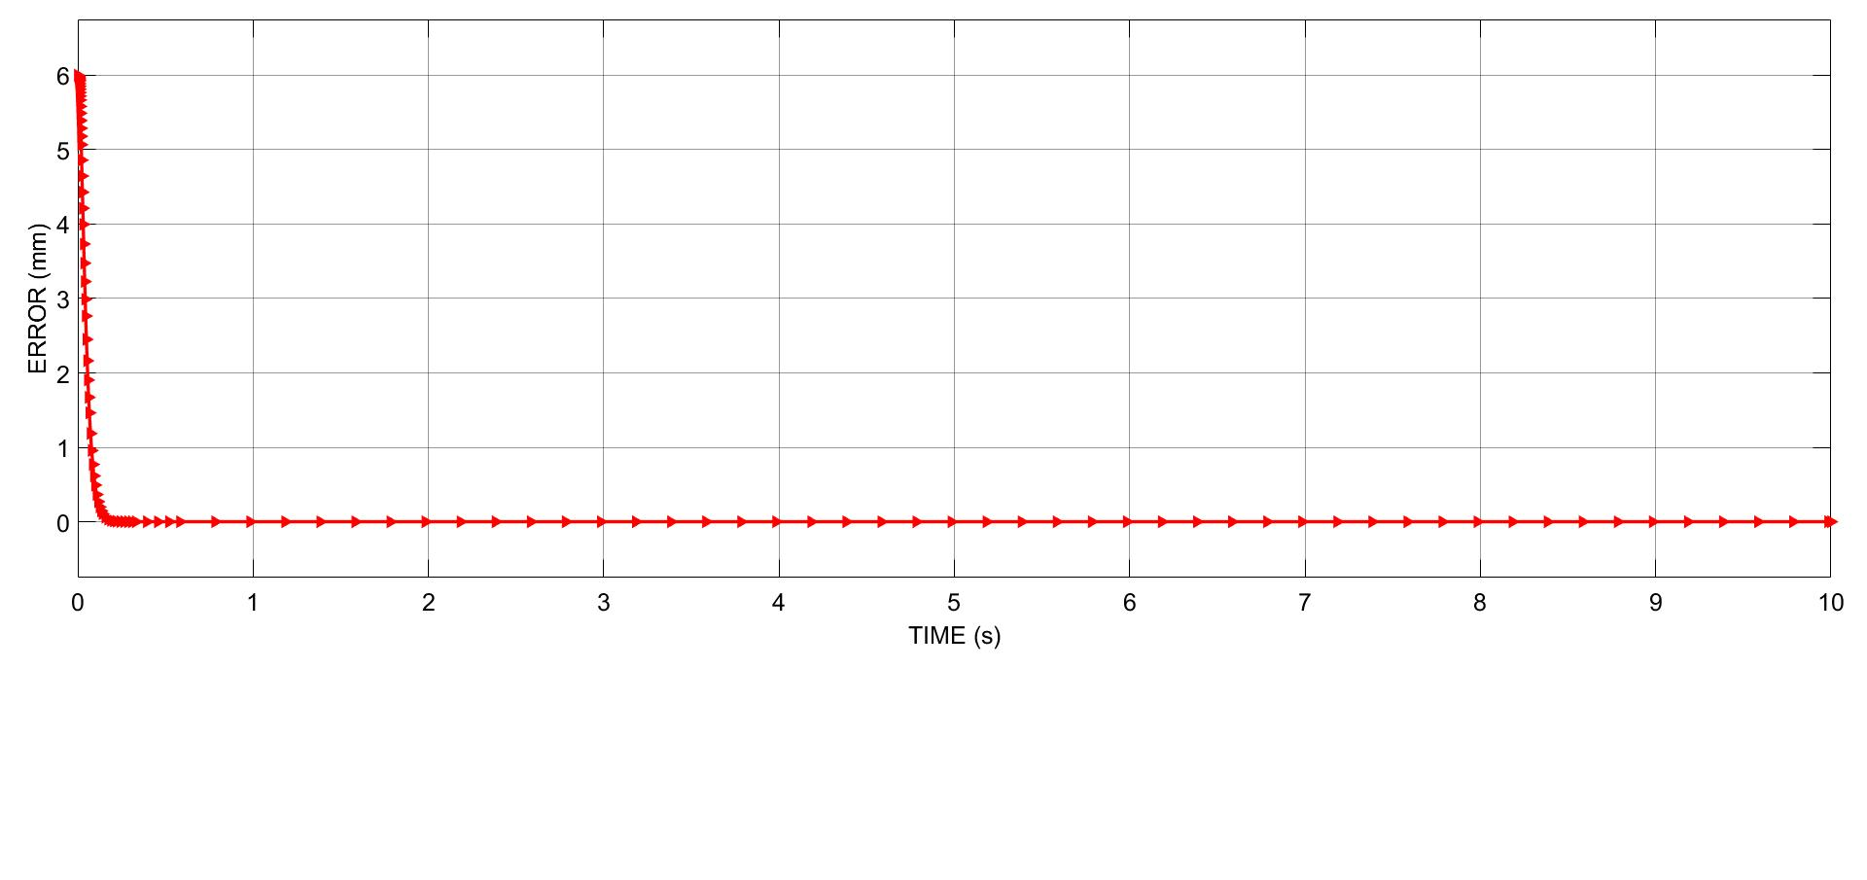
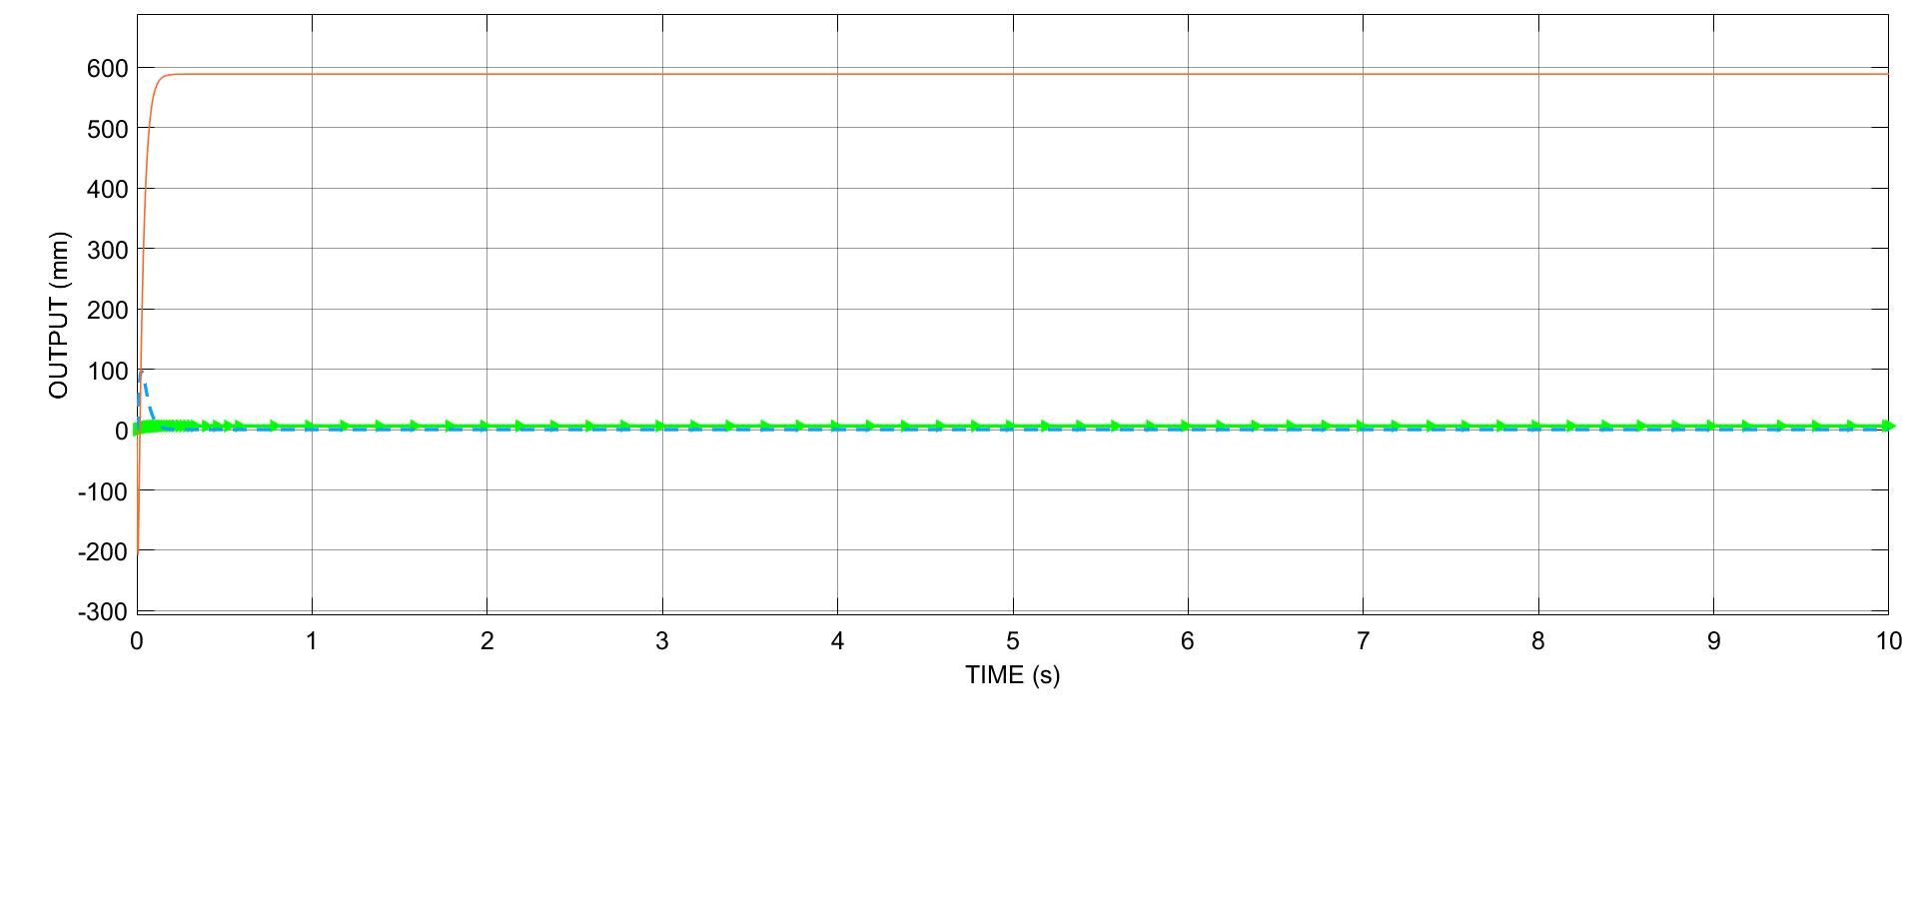
Cont.…
Case:3-qreff=6mm, p=0, v=0

Slide 23
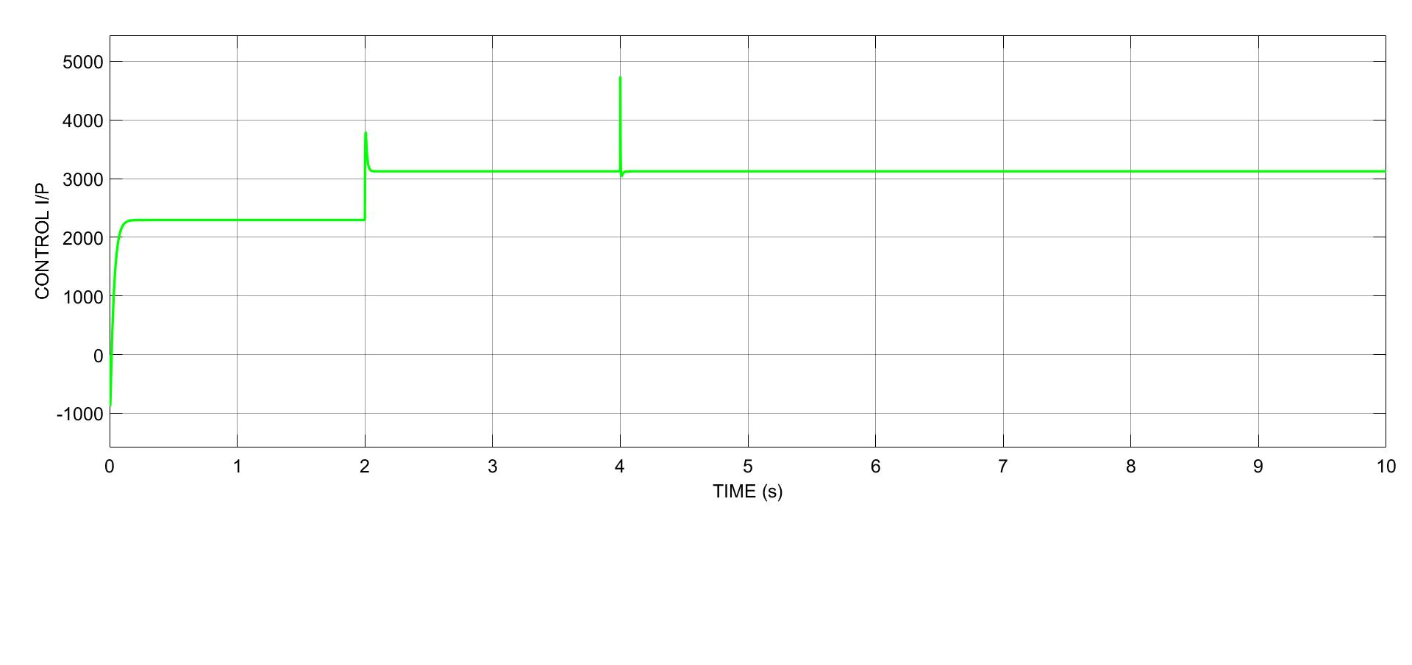
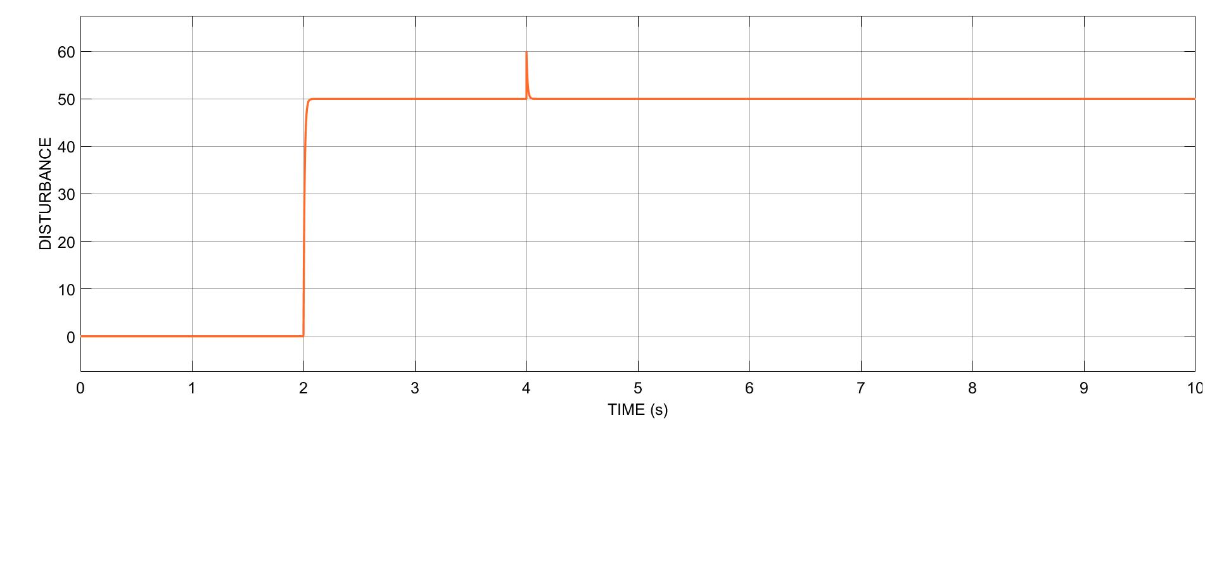
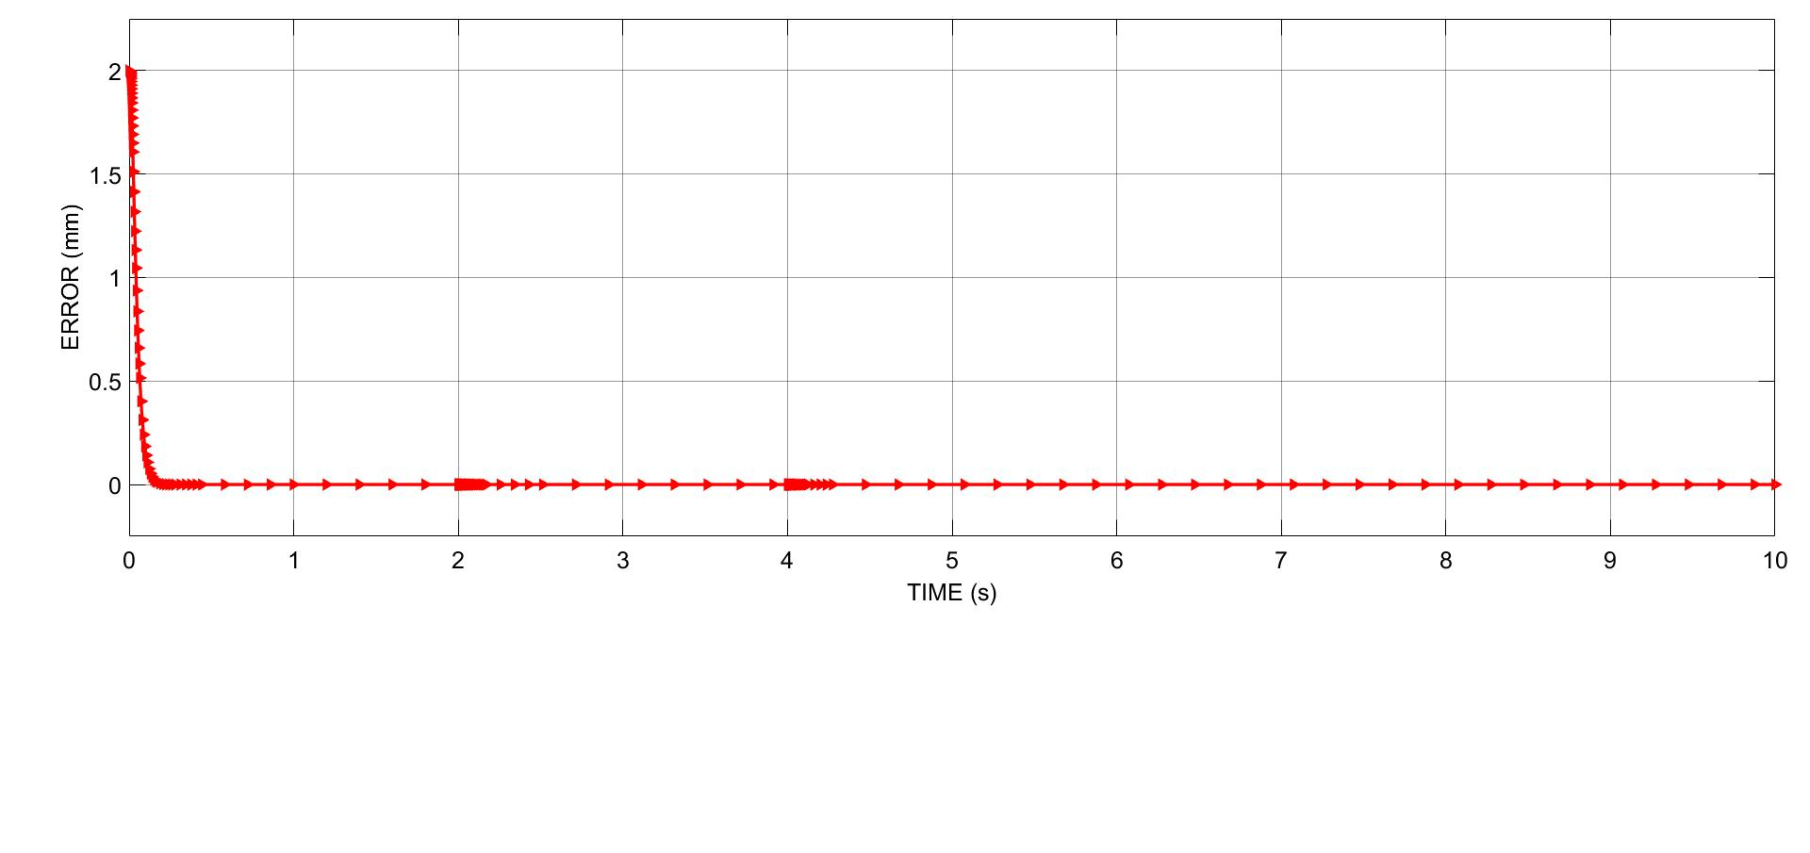
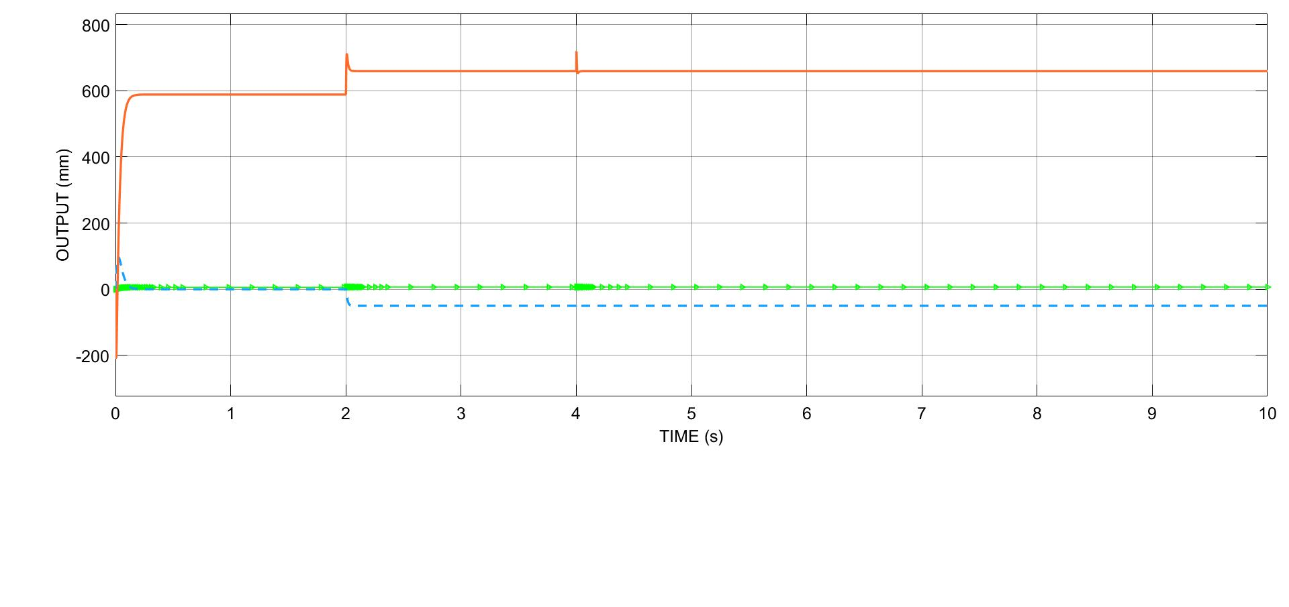
Cont.…
Case:4-qreff=2mm, p=50 at t=2s, v=0.1 at t=4

Slide 24
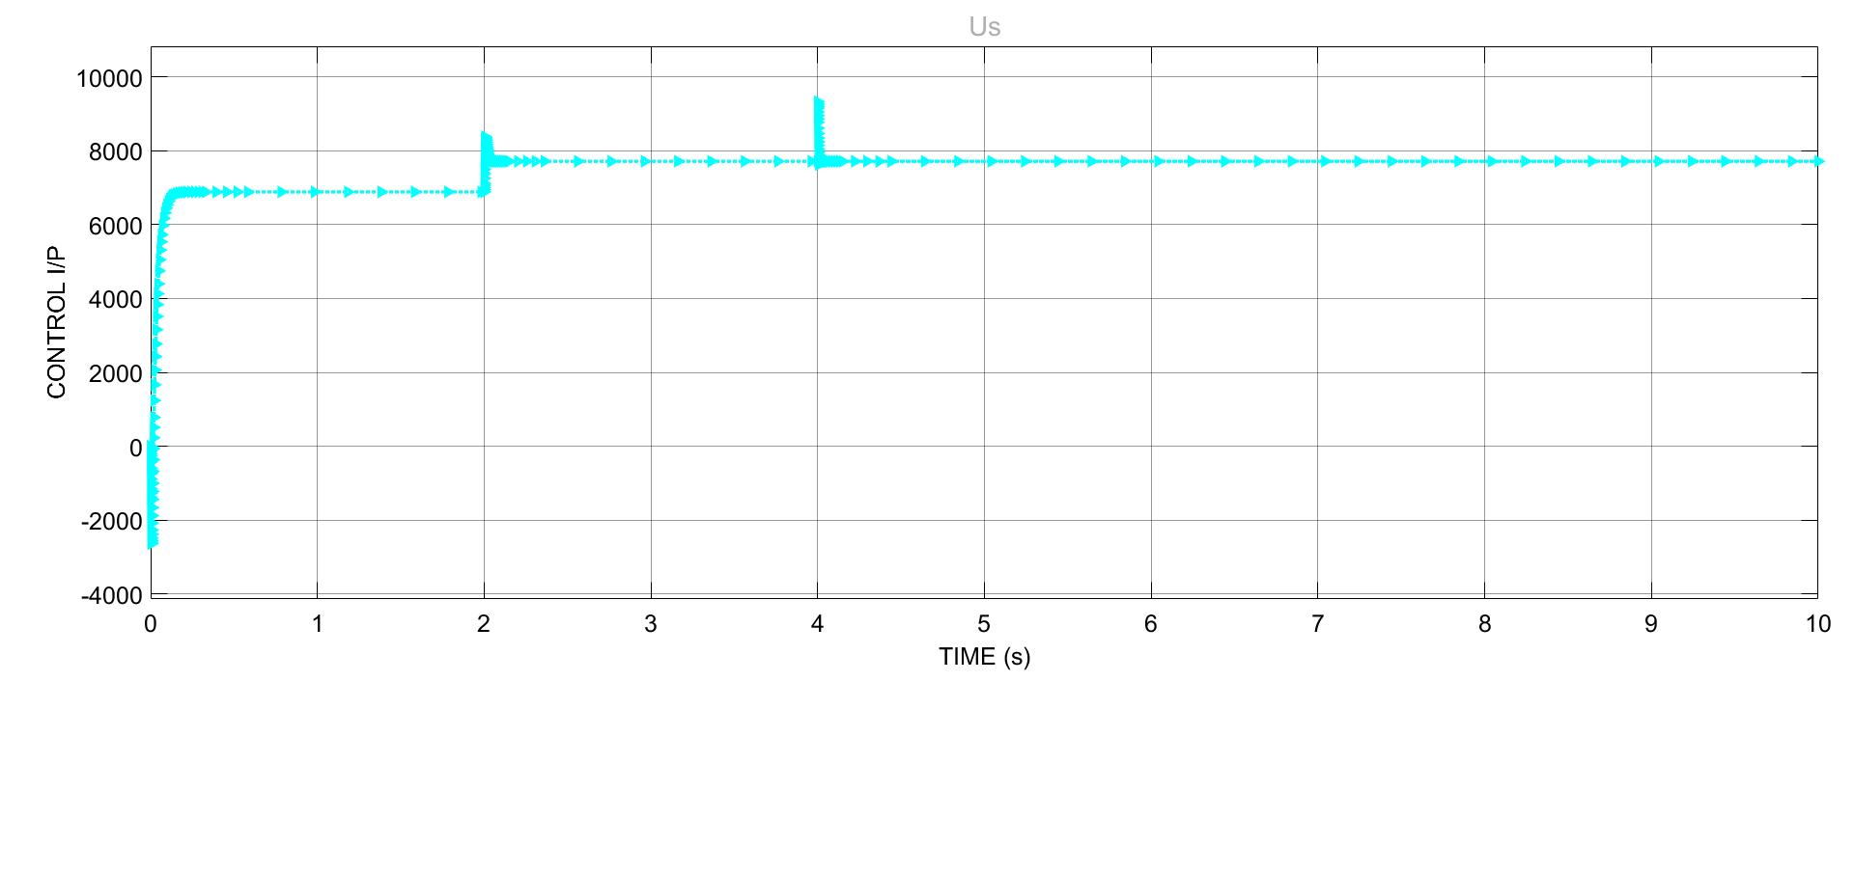
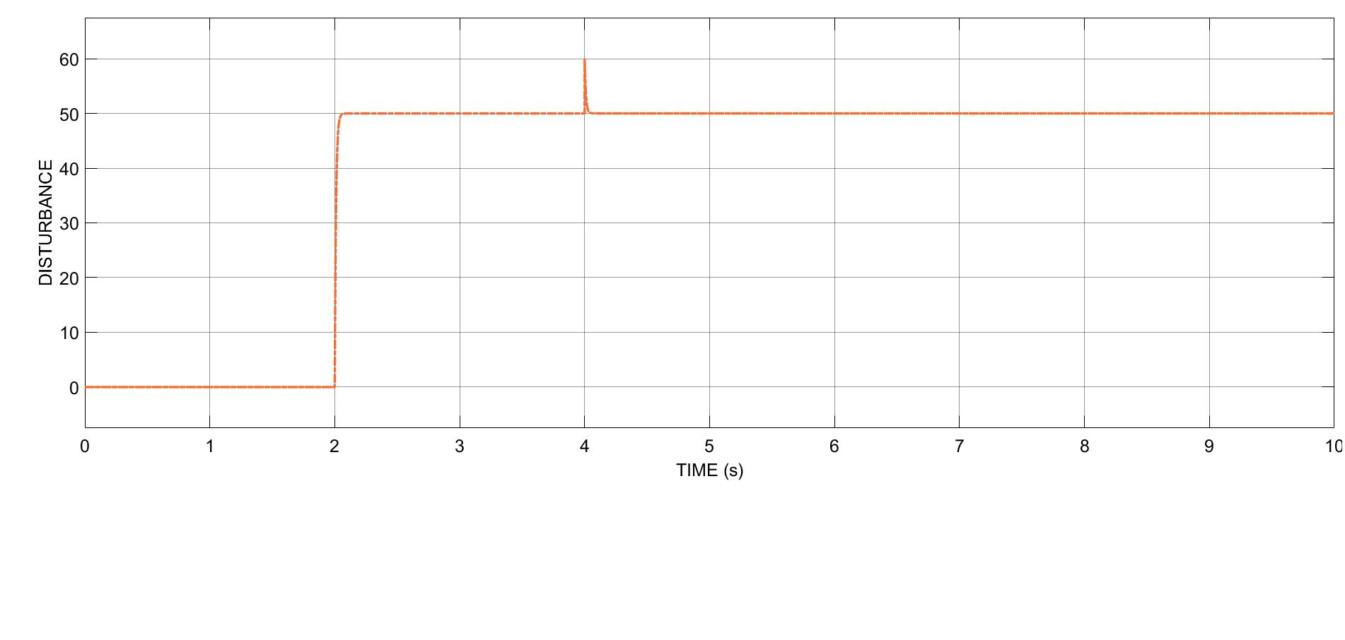
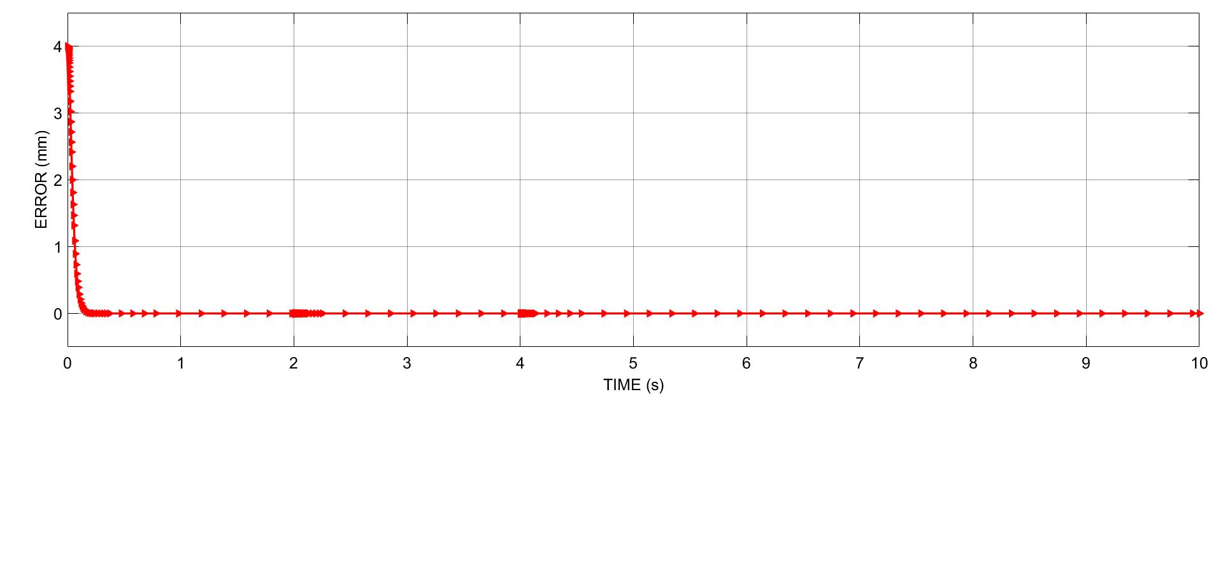
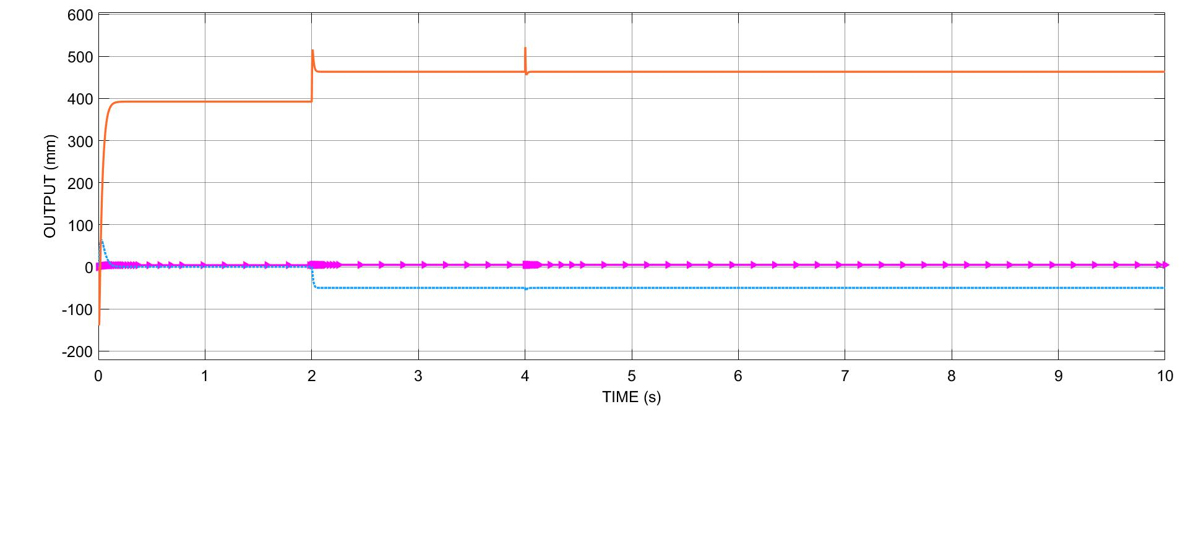
Cont.…
Case:5-qreff=4mm, p=50 at t=2s, v=0.1 at t=4

Slide 25
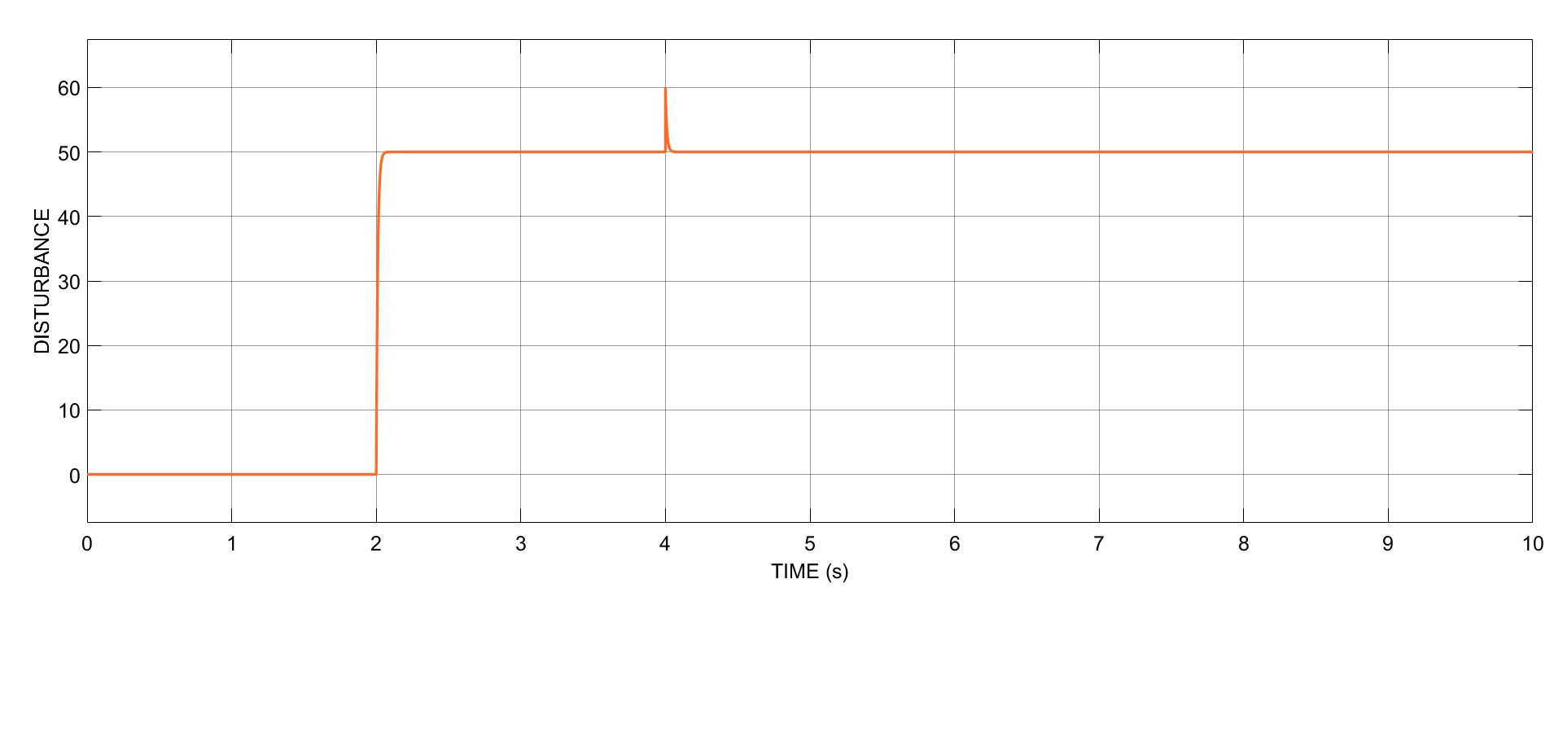

Cont.…
Case:6-qreff=6mm, p=50 at t=2s, v=0.1 at t=4

Slide 26




Cont.…
4. According to conditions we have three cases for Q.4:
qreff =
qreff =
qreff =
∴ ∆ A=
P=0, v=0
P=50 at t=2s & v=0.1 at t=4s
P=50 at t=2s & v=0.1 at t=4s with ‘∆ A’

Slide 27




Cont.…
Case:1-qreff= , p=0, v=0 & fr=10hz, A =2

Slide 28




Cont.…
Case:2-qreff= , p=50 at t=2s, v=0.1 at t=4 & fr=10hz, A =2

Slide 29





Cont.…
Case:3-qreff= , p=50 at t=2s, v=0.1 at t=4 & fr=10hz, A =2 with ∆ A

Slide 30


PART:2
DESIGN OF H-INFINITY BASED ROBUST CONTROLLER:
Given condition,
1. STATE SPACE MODEL:

Slide 31

Cont.…
2. CLOSED-LOOP H-INFINITY CONTROLLER DESIGN:
H-infinity norm:
It is the max value of frequency norm or maximum amplification for any sinusoidal frequency

Slide 32


Cont.…
The equation to be controlled is given as,
For the given plant,
Here, D12 and D21 are key parameters.

Slide 33


Cont.…
Noe after applying H-infinity procedure we will get,
Transfer function for controller,
CLOSED-LOOP SYSTEM
Where, K(S) = Transfer function of controller
r = qref
y = q
Z_{∞ =} e
This represents closed-loop system.

Slide 34





Cont.…
ACCORDING TO CONDITIONS WE HAVE SIX CASES FOR Q.3:
Proposed block diagram:

Slide 35



Cont.…
Case: -qref=4mm, p=50 at t=2s, v=0.1 at t=4

Slide 36



Cont.…
Case:-qref=6mm, p=50 at t=2s, v=0.1 at t=4

Slide 37




Cont.…
ACCORDING TO CONDITIONS WE HAVE TWO CASES FOR Q.4:
Case:1-qreff=4+2Sin(20∏t) mm, p=0 v=0, fr=10hz, A =2

Slide 38




Cont.…
Case:2-qreff=4+2Sin(20∏t) mm, p=50 at t= 2, v=0.1 at t=4, fr=10hz, A =2

Slide 39
ACKNOWLEDGMENT(S)
Dr. Qing-Chang Zhong, Dept. of ECE
Duo Wang, TA, ECE533, Dept. of ECE
MATHWORKS, MATLAB/SIMULINK
MATHCHA, ONLINE EQUATION WRITIMG, https://www.mathcha.io/editor
IEEE Xplore

Slide 40
CONCLUSION
In this project we investigated and designed UDE and H∞ controller for Maglev concept. Controller performance in presence of disturbance and noise is best in terms of disturbance rejection.
It tracks the desired performance in very short noise time.
It can be used to make stable an unstable plant.
Best part of UDE controller is it not only rejects disturbance; it also estimates the disturbance where H∞ controller modelling was simpler as compared to UDE but H∞ controller takes more time to obtain response during operation.
In this design, the controller parameters have been adjusted such that the system output tracks the output of the model reference. The proposed controller has achieved an asymptotic tracking of prescribed reference output with compensating the system parameters uncertainty. A variation of ±10% in system parameters has been considered.

Slide 41
CITATION(S)
[1] Q.-C. Zhong and D. Rees, “Control of uncertain LTI systems based on an uncertainty and disturbance Estimator,” Journal of Dyn. Sys. Meas. Con.Trans. ASME, vol. 126, no. 4, pp. 905–910, Dec. 2004.
[2] Q.-C. Zhong, A. Kuperman, and R. Stobart, “Design of UDE-based controllers from their two-degree-offreedom nature,” International Journal of Robust and Nonlinear Control, vol. 21, pp. 1994–2008, Nov. 2011.
[3] B. Ren, Q.-C. Zhong, and J. Dai, “Asymptotic reference tracking and disturbance rejection of UDE-based robust control,” IEEE Trans. Ind. Electron., vol. 64, no. 4, pp. 3166–3176, Apr. 2017.
[4] J. Chen, B. Ren, and Q.-C. Zhong, “UDE-based trajectory tracking control of piezoelectric stages,” IEEE Trans. Ind. Electron., vol. 63, no. 10, pp. 6450–6459, Oct 2016.
[5] R. Sanz, P. García, Q.-C. Zhong, and P. Albertos, “Predictor-based control of a class of time-delay systems and its application to quadrotors,” IEEE Trans. Ind. Electron., vol. 64, no. 1, pp. 459–469, Jan 2017.
[6] Y. Wang, B. Ren, and Q.-C. Zhong, “Robust power flow control of grid-connected inverters,” IEEE Trans. Ind. Electron., vol. 63, no. 11, pp. 6887–6897, Nov. 2016.
[7] B. Ren, Y. Wang, and Q.-C. Zhong, “UDE-based control of variable-speed wind turbine systems,” International Journal of Control, vol. 90, no.1, pp. 121–1362017.
[8] Z. Tian, Q.-C. Zhong, B. Ren, and J. Yuan, “Sterilizability analysis and design of UDE-based robust control,” IET Control Theory Applications, vol. 13, no. 10, pp. 1445–1453, 2019.
[9] S.K. Choudhary, “Robust Feedback Control Analysis of Magnetic Levitation System”, WSEAS Transactions on Systems. Vol. 13, pp. 285-291, 2014.
[10] I. Ahmad and M. A. Javaid, “Nonlinear Model and Controller Design for Magnetic Levitation System”, Recent Advances in Signal Processing, Robotics and Automation, University of Engineering & Technology, Taxila, Pakistan, 2012.
[11] MATHWORKS, MATLAB TUTORIAL H-Infinity Performance - MATLAB & Simulink (mathworks.com)

Slide 42

THANK YOU

